Slide 1

Statistical Methods in Research (COSC 6323) Brain Science
Submitted By:
Sachin Shubham

Slide 2

Milestone 1:
Objective:
To produce the manuscript's Figure 2A and 2B. Figures illustrates the trends in cross-domain scholarship in Human Brain Science.
Requirements:
R Language & Gephi software.

Slide 3
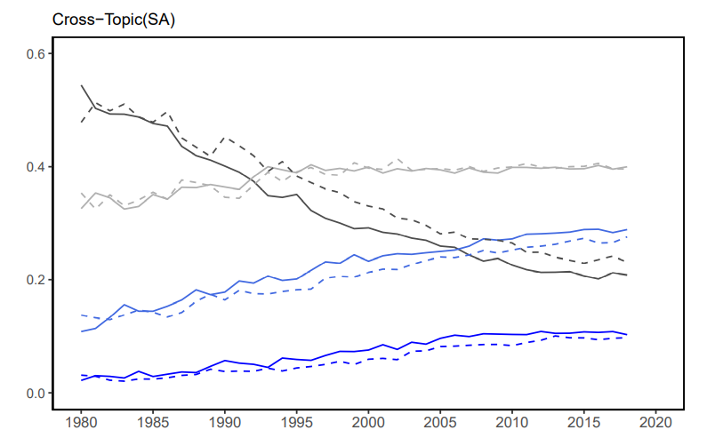
Figure 2A Part 1: Cross-Topic (SA)

Slide 4
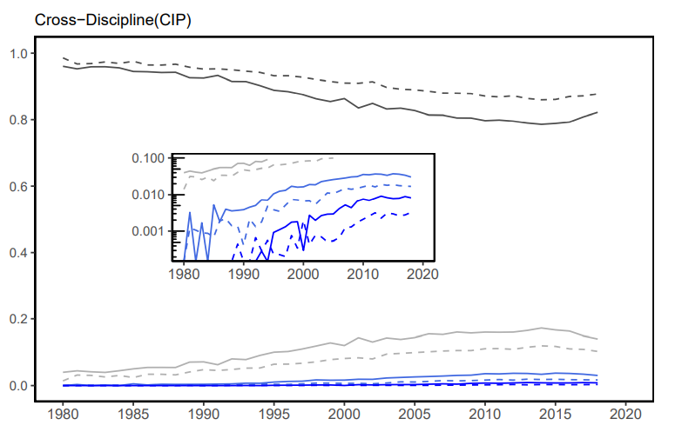
Figure 2A Part 2: Cross-Discipline (CIP)

Slide 5
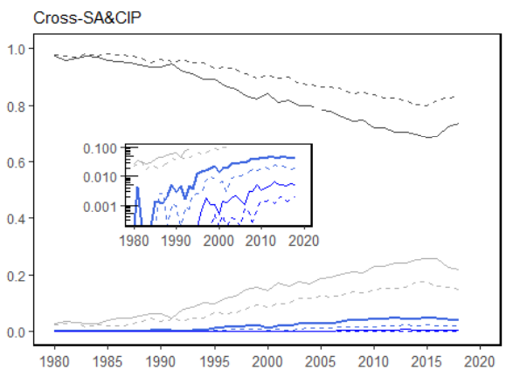
Figure 2A Part 3: Cross – SA & CIP

Slide 6
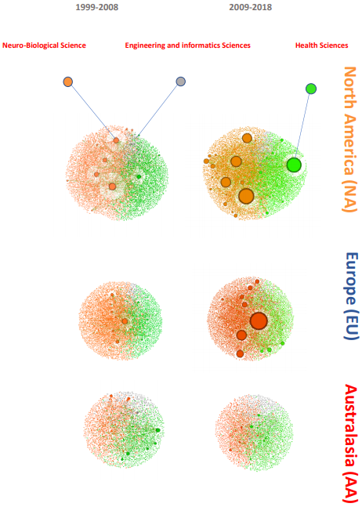
Figure: 2B
Snapshots of the collaboration network at 10-year intervals indicating researcher population sizes by region, and the densification of convergence science at cross-disciplinary interfaces.

Slide 7
Milestone 2:
Objective:
To produce the manuscript's Figure 3A and 3B. Figures Evolution of SA boundary-crossing within and across disciplinary clusters.
Requirements:
R & Sankey Diagrams.

Slide 8
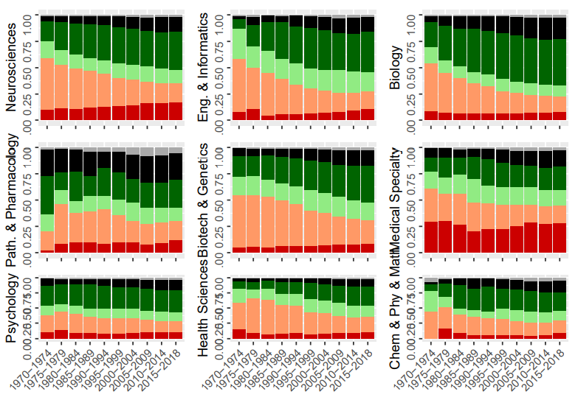
Figure 3A
Disciplinary Clusters (CIP) Correspondence with topical (SA’s) cluster as fraction of MeSH, by 5-year period.

Slide 9
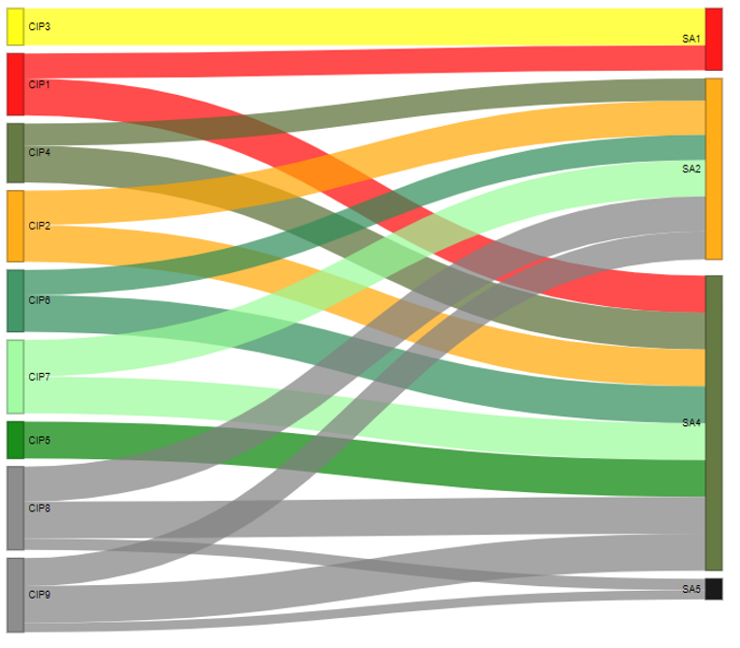
Figure 3B Part 1
CIP-SA Coupling in Mono-Domain Articles (2009-2018)

Slide 10
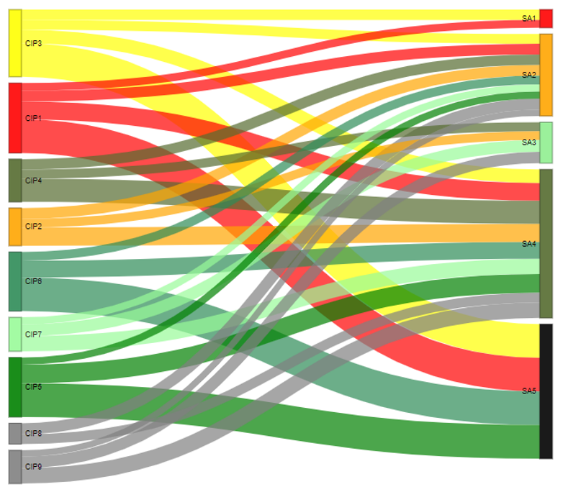
Figure 3B Part 2
CIP-SA Coupling in Cross-Domain Articles (2009-2018)

Slide 11
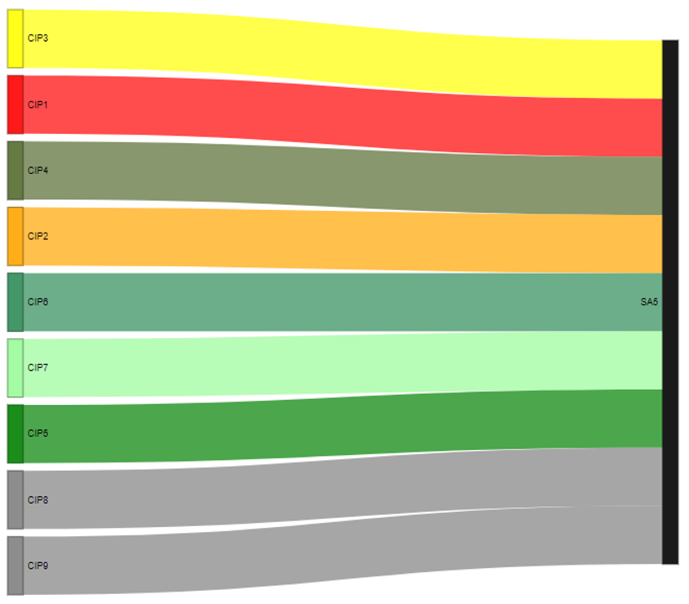
Figure 3B Part 3
Difference Between SA and CIP Coupling Networks (2009-2018)

Slide 12
Milestone 3:
Objective:
To produce the manuscript's Figure 5 and Tables from S1 to S5.
Here Figure shows the Propensity for X and citation impact attributable to cross-domain activity at the article level.

Slide 13
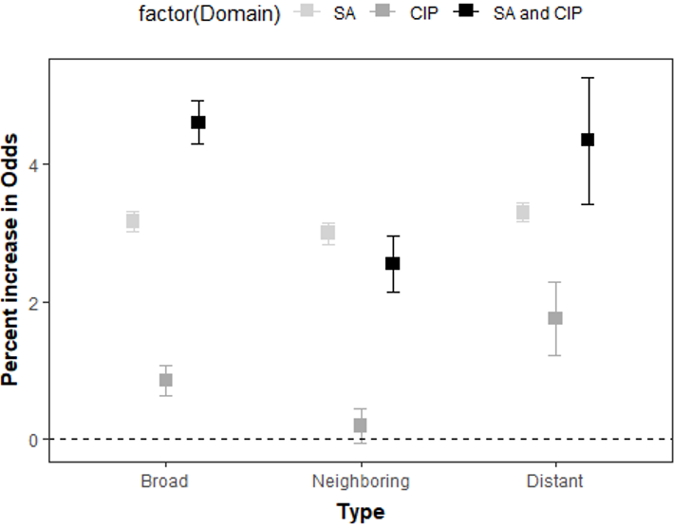
Figure 5A
Annual growth rate in the likelihood P(X) of research having cross domain attributes represented generically by X.

Slide 14
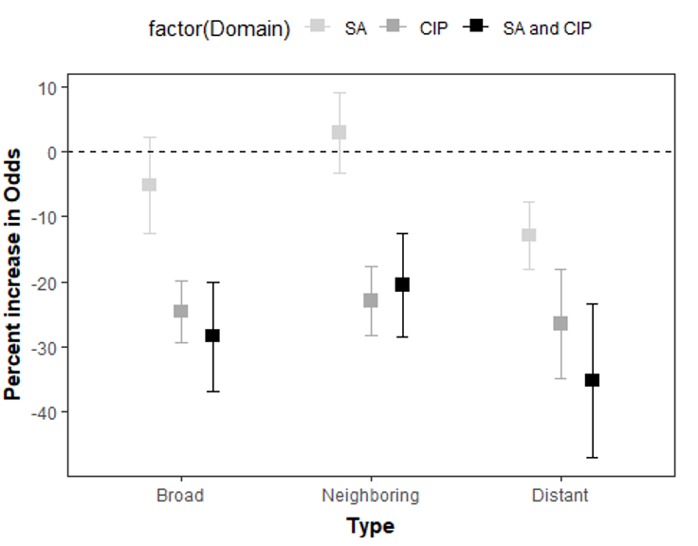
Figure 5B
Decreased likelihood P(X) after 2014

Slide 15
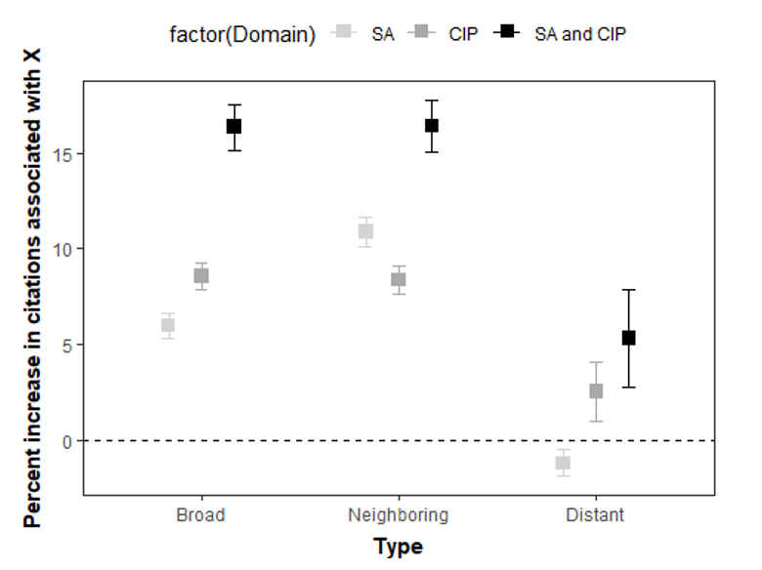
Figure 5C
Citation premium estimated as the percent increase in cp attributable to cross-domain mixture X, measured relative to mono-domain (M) research articles representing the counterfactual baseline. Calculated using a researcher fixed-effect model specification which accounts for time independent individual-specific factors.

Slide 16
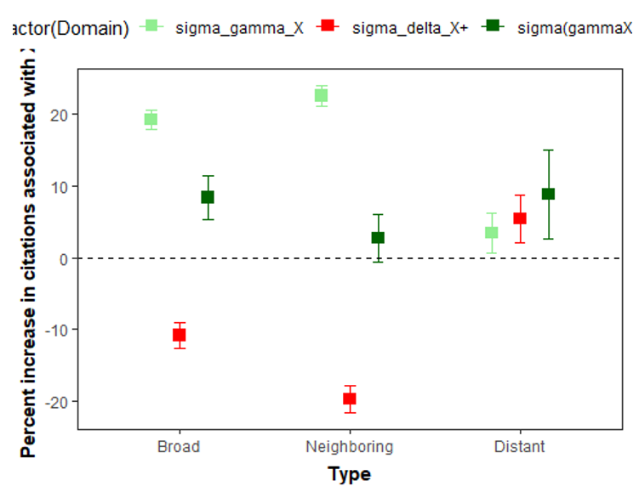
Figure 5D
Difference-in-Difference (δX+) estimate of the “Flagship project effect” on the citation impact of cross-domain research.

Slide 17
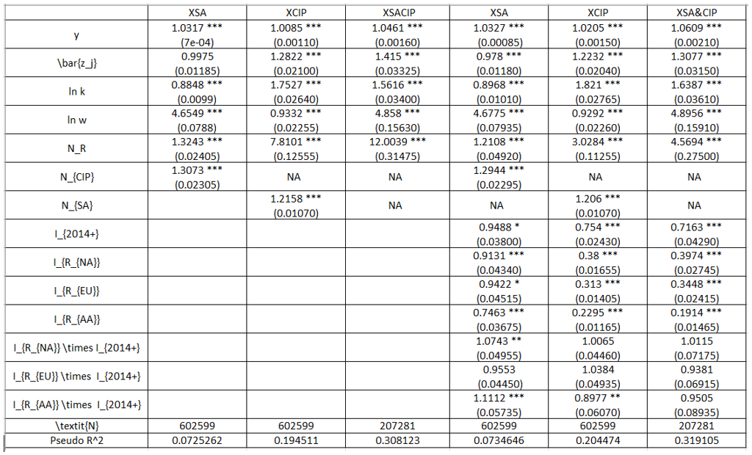
Table S1

Slide 18
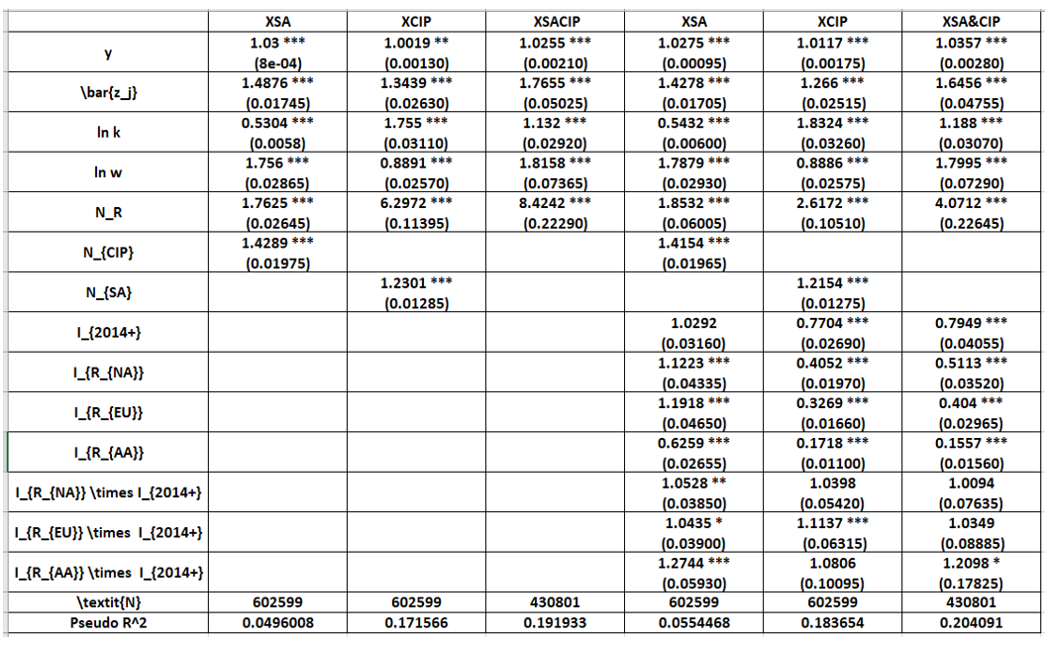
Table S2

Slide 19
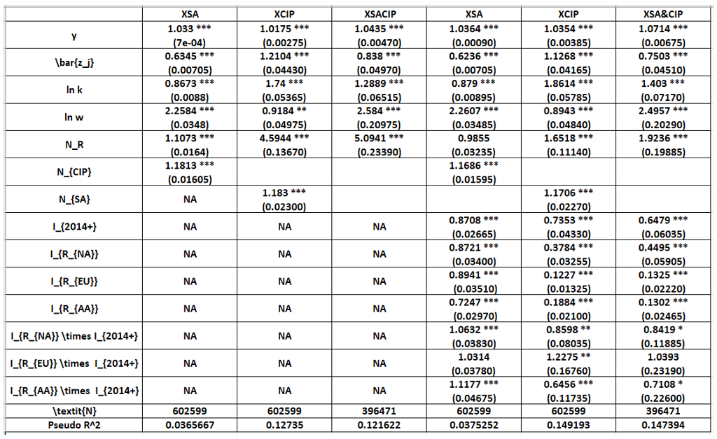
Table S3

Slide 20
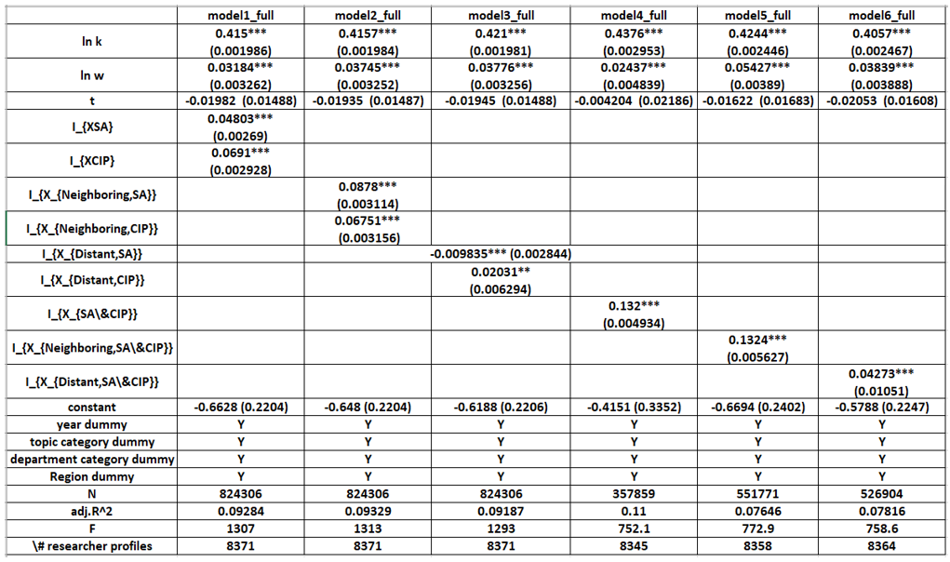
Table S4

Slide 21
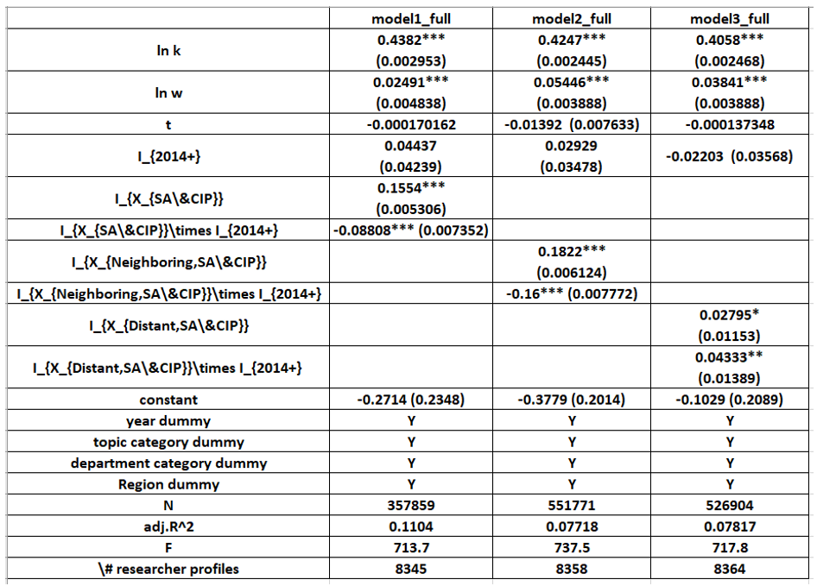
Table S5

Slide 22


